Slide 1
JAVA Lecture 24
JSP

Slide 2
What is JSP?
JSP (Java Server Pages) is a technology for creating dynamic web pages using Java.
A JSP file is a .jsp file containing HTML + embedded Java code.
JSPs are compiled into servlets behind the scenes.
✅ Best suited for presentation logic (HTML, UI).

Slide 3
JSP Architecture Overview
Client sends a request to a .jsp page.
The JSP is compiled into a servlet by the web container.
Servlet executes, generating dynamic HTML.
Response is sent back to the browser.
✅ JSP is part of the MVC architecture, typically for the View layer.

Slide 4
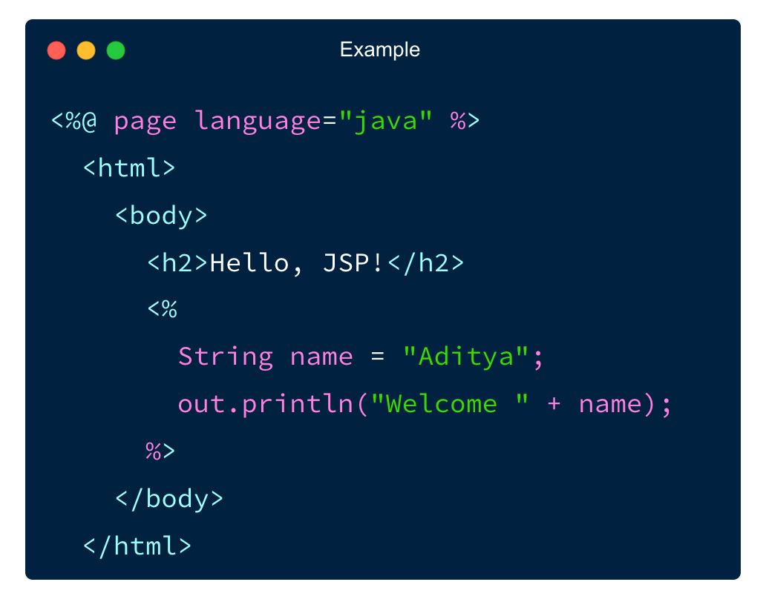
Basic Syntax of a JSP Page
✅ Combines HTML and Java code easily.

Slide 5
JSP Scripting Elements
Element | Syntax | Purpose
Declaration | <%! ... %> | Declares variables or methods
Scriptlet | <% ... %> | Contains Java code
Expression | <% =... %> | Outputs value to client
✅ Use scriptlets sparingly – prefer JSTL/EL in modern JSPs.

Slide 6
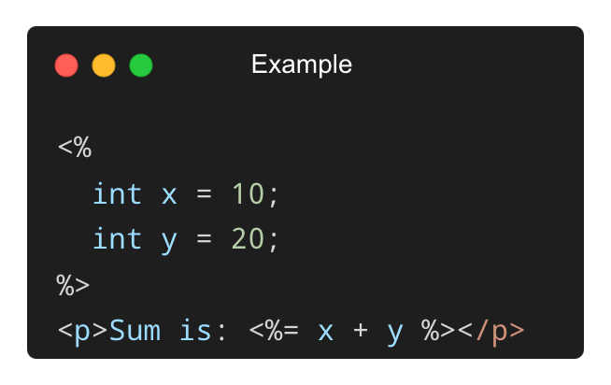
Example – Expression and Scriptlet
✅ <%= ... %> automatically writes output to the response.

Slide 7
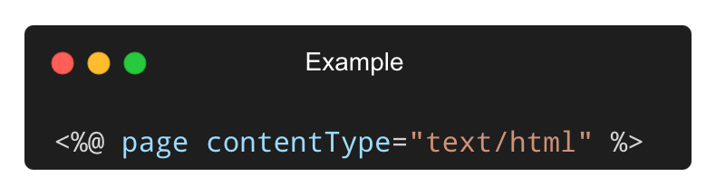
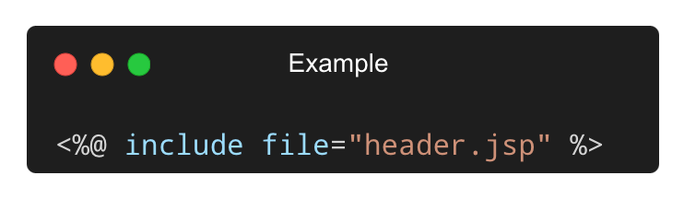
JSP Directives and Include
Page Directive:
Include Directive:
✅ Directives configure the JSP page or include shared content.

Slide 8
What is a Session?
A session represents a user’s interaction with a web application across multiple requests.
HTTP is stateless, so session tracking is needed to maintain continuity.
JSP provides built-in support through the session object.
✅ Each session is unique per user and managed by the server.

Slide 9
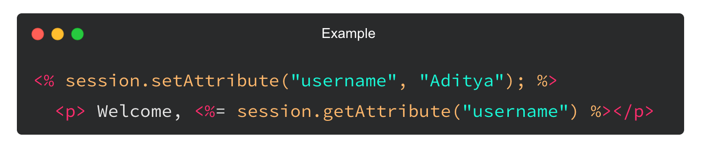
Accessing the Session Object in JSP
JSP provides session implicitly:
✅ Data stored in session is available across multiple pages.

Slide 10
Common HttpSession Methods
Method | Description
setAttribute(String, Object) | Stores data in session
getAttribute(String) | Retrieves data from session
removeAttribute(String) | Removes a session attribute
invalidate() | Ends the current session
✅ Used to manage login status, cart items, preferences, etc.

Slide 11
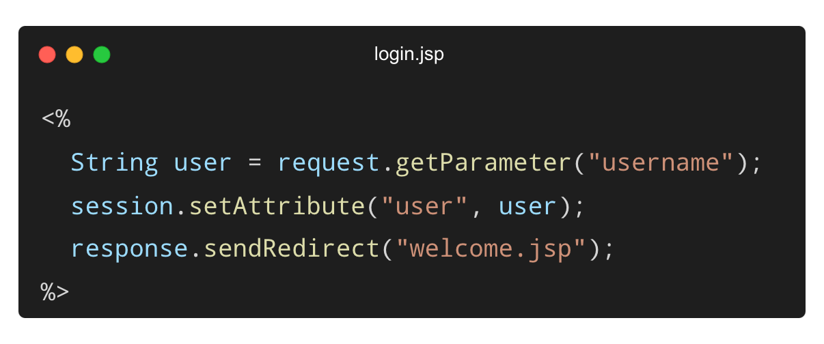
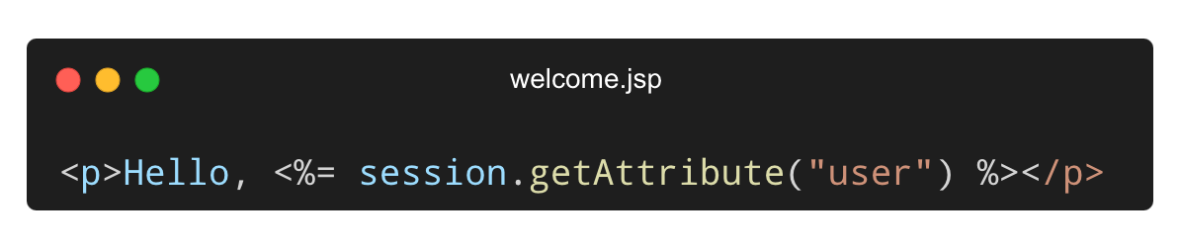
Example – Login and Welcome Pages
✅ Simple demonstration of using session to track user login.

Slide 12
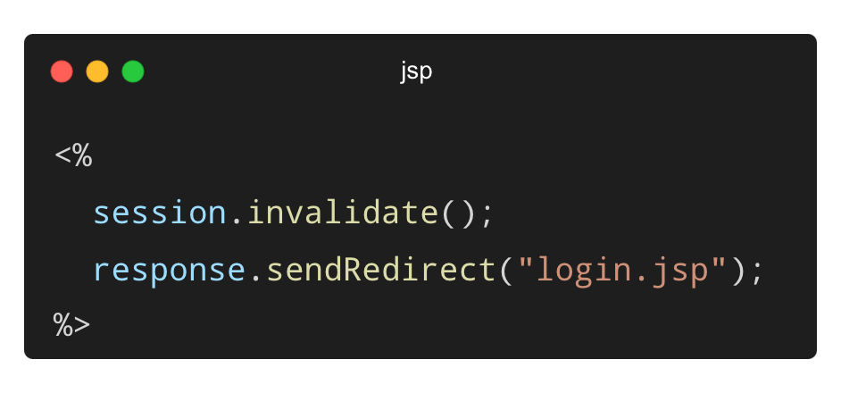
Invalidating a Session (Logout)
✅ Ensures all session data is cleared, logging the user out safely.

Slide 13
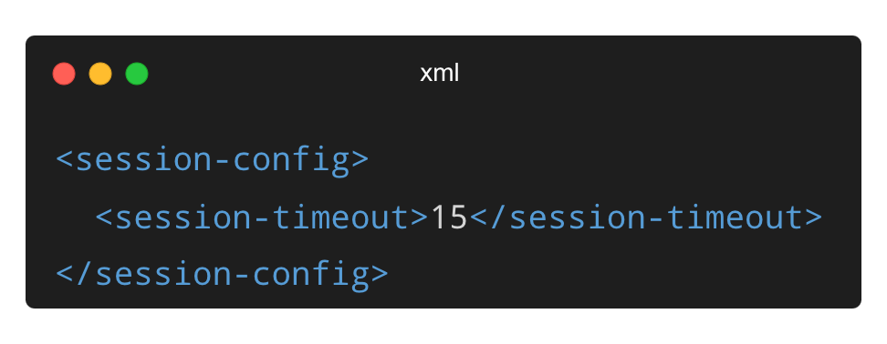
Session Timeout and Management
Default timeout: 30 minutes (configurable in web.xml)
✅ Timeout helps manage memory and enhance security.

Slide 14
THANK YOU

